Slide 1
Best Practices for Implementing a Paradata Warehouse
Presentation at the Washington Statistical Society Mini-Conference on Paradata
Washington, D.C.
January 26, 2016
Jason Markesich • Shawn Marsh
Nathan Darter • Sean Harrington

Slide 2
Introduction
Our Paradata Warehouse tracks hundreds of variables associated with each survey sample. By analyzing these paradata, we can tailor and modify data collection in real time, as new information is learned, to improve effectiveness and efficiency.
Mathematica recently launched the Paradata Warehouse, a single, centralized data repository flexible enough to use on a single project or across multiple projects.

Slide 3
Presentation Roadmap
Overview of the Paradata Warehouse
Benefits
System features
Architecture
Report examples
Ensuring data quality through standardization
Testing and validation processes
Data visualization tools and design principals
Suggestions for promoting user adoption
Final thoughts and lessons learned

Slide 4
Benefits of the Paradata Warehouse
Improves access to paradata from many different data sources
4
Can be used in tandem with advanced statistical techniques to monitor and improve data quality
1
2
Allows staff to manage with the data they want rather than the data they get
5
Reduces programming costs associated with writing and supporting standard and ad-hoc reports outside of the warehouse
3
Facilitates decision-making that allow staff to make mid-course corrections within an adaptive design framework
6
Enables cross-survey analysis to support design and budgeting decisions

Slide 5
System Features
Cost and production reports related to telephone interviewing, “in-house” locating, field locating/interviewing and data collection supervision
Interactive dashboards that enable staff to “drill down” into paradata
A metadata repository that collects information on survey characteristics

Slide 6
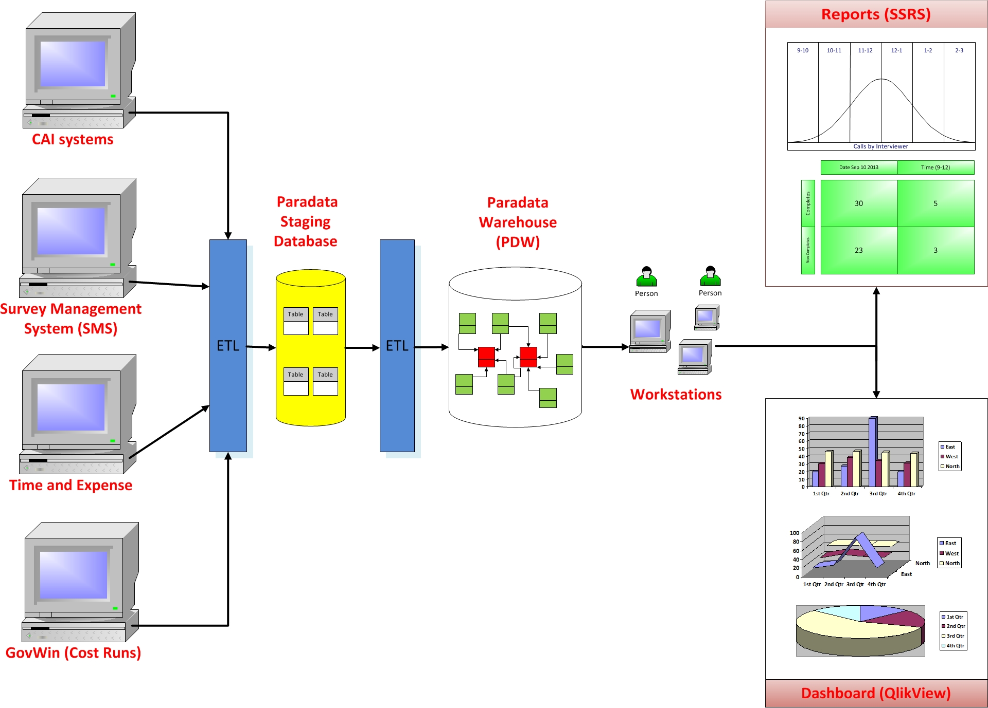
High-Level Paradata System Architecture

Slide 7
Paradata Reports
Current Paradata Reports are Used to Answer the Following Data Collection Questions…
Telephone Interviewing
How productive are interviewers?
How many hours are spent per complete?
When are we most likely to reach respondents?
What is the level of effort for completing cases?
When should we stop calling cases?
Appointments and Refusals
How successful are we converting refusals?
How many calls are we making per refusal case?
Are we meeting our firm appointments?
What is the outcome of scheduling appointments?

Slide 8
Paradata Reports (cont)
Current Paradata Reports are Used to Answer the Following Data Collection Questions…
In-House Locating
How productive are locators?
How many hours are spent on a locating case?
What percentage of the sample did we locate?
Field Data Collection
How productive are field staff?
How many hours are spent per complete?
What is the level of effort to locate respondents in the field?
How are field expenses impacting the budget?
Data Collection Costs
What is the overall cost per complete?
How does the cost per complete change over time?
Are specific modes driving costs?

Slide 9
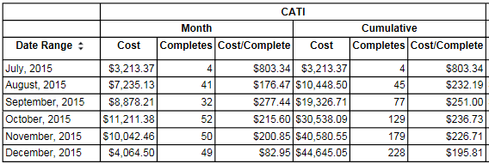
Paradata Report Example

Slide 10
Ensuring Data Quality Through Standardization and Testing

Slide 11
Status and Charge Codes
A well-thought out and well-executed status code system is critical to ensuring that the cost and production indicators are valid, and to conduct meaningful cross-survey analysis
Accurate reporting of cost information requires that project charge codes are set up correctly

Slide 12
Metadata Management
We created the Project and Instruments Characteristics Site (PICS), a one-stop portal for recording metadata that can be used to facilitate cross-survey analysis in the warehouse
Examples of metadata collected:
Sponsoring agency
Survey population
Mode(s), language(s) and length of administration
Study design and sample frame
To ensure end-users metadata are standardized, we use a standard taxonomy for the metadata terms

Slide 13
Testing Processes
Testing activities begin in the requirement-gathering phase and are carried out in an iterative manner
Types of testing:
Data completeness
Data transformation
Data quality
Scalability and performance
Regression tests
Every component of the warehouse needs to be tested, both independently as well as when integrated. This includes testing the:
ETL scripts
The paradata warehouse itself
Reporting scripts
Front end / user interface

Slide 14
Data Visualization

Slide 15
Data Visualization Tools
DV tools help engage users by providing answers faster and in an easy-to-understand format, and fosters creativity in their decision making
Dashboards and graphical displays make it easier to spot trends and behavior patterns and simplifies the process for drilling into the data
Useful for providing clients with a high-level summary of data collection production

Slide 16
Data Visualization Design Principals
Match DV capabilities to users’ roles/responsibilities, and level of interest
Data collection supervisors vs. survey directors and statisticians
Provide users with the ability to manipulate data without being dependent on programmers
Choose the most basic visualization available that can effectively convey the intended message, and:
Present information hierarchically
Avoid visual clutter
Use colors appropriately to maximize impact

Slide 17
Promoting User Adoption
Simplify processes and designs
Engage users by providing updates throughout the development and implementation phases
Develop a training program that’s regular, on-going and easy-to-understand

Slide 18
Final Thoughts and Lessons Learned
Start small and build incrementally
Provide flexibility to allow for significant changes in data warehousing functionality and integration of new data sources
Some lessons learned:
Get advice from data warehousing experts/consultants at the outset of the project
Identify someone on the project team whose job is to focus exclusively on project management
Identify project staff, not IT staff, who will be responsible for validating the paradata reports and indicators

Slide 19
For More Information
Jason Markesich
JMarkesich@mathematica-mpr.com
Shawn Marsh
SMarsh@mathematica-mpr.com
Nathan Darter
NDarter@mathematica-mpr.com
Sean Harrington
SHarrington@mathematica-mpr.com

